Slide 1
SCIENCE
TECHNOLOGY
ENGINEERING
MATHEMATICS

Slide 2
Empowering STEM candidates for employability and entrepreneurship with enhanced non-technical soft and transversal skills
Erasmus+ KA226 – Partnerships for Digital Education Readiness
2020-1-NO01-KA226-VET-094190

Slide 3
Skillsbank/Canvas Platform
End user presentation
TECHNOLOGY
ENGINEERING
SCIENCE
MATHEMATICS

Slide 4
Skillsbank – What is it?
Database of learning outcome qualification matrices
Validation of prior learning (RPL)
CV functionality
MOOC repository and integration with Canvas
Video repository
Repository of OERs (Open education resources)
Multilingual interface and matrices (19 languages)

Slide 5
How to navigate the platforms
https://skillsbank.eu/

Slide 6
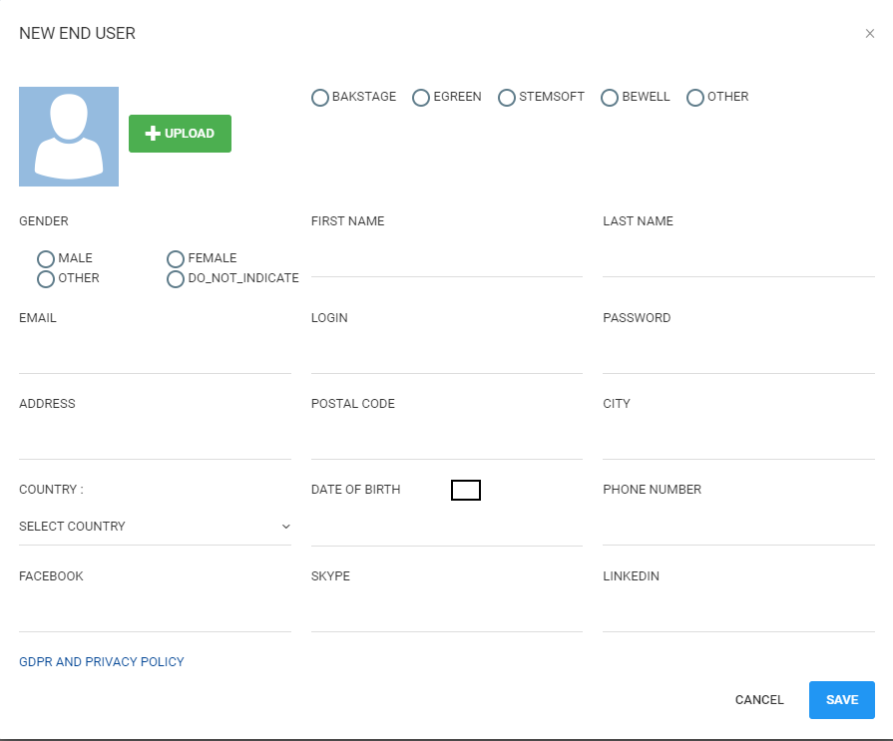
User creation

Slide 7
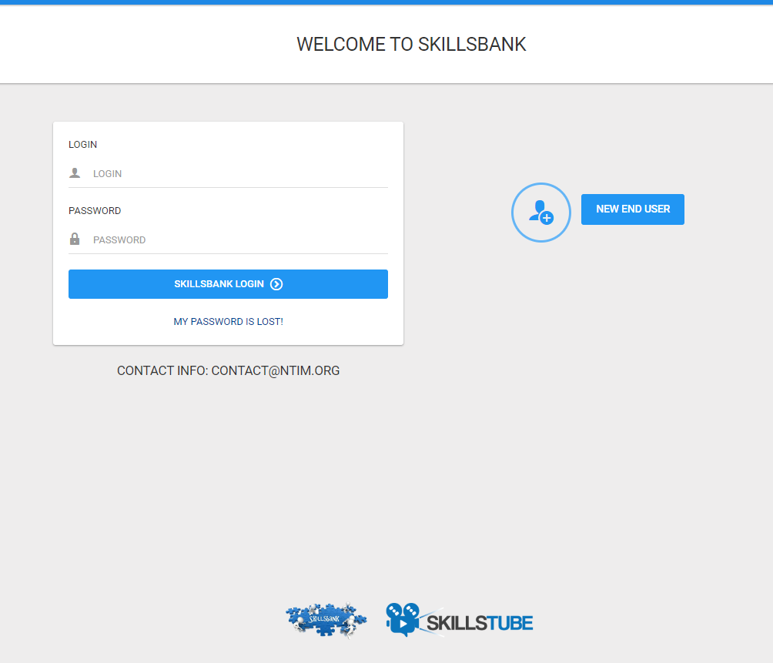
Login page
Click on: NEW END USER

Slide 8
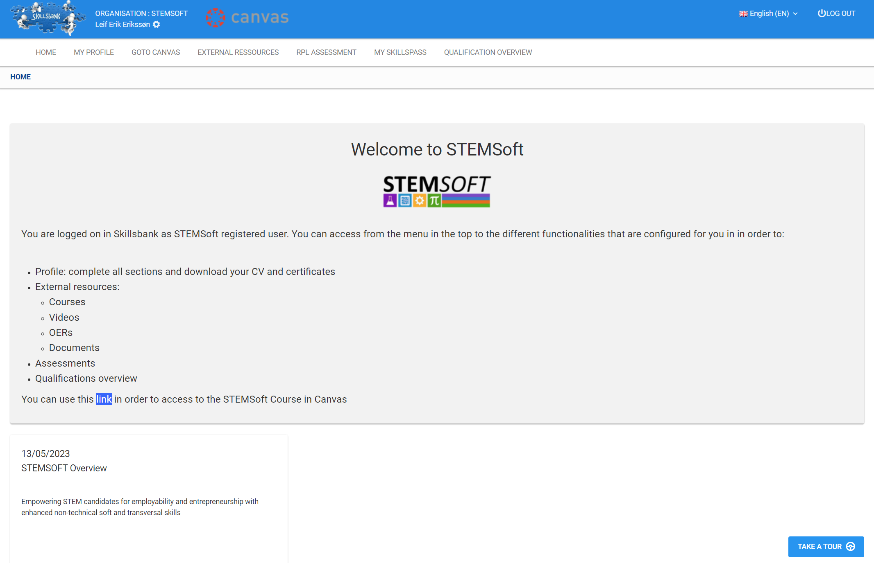
Home page
Main menu
Skillsbank functionality is presented in the next slides.
Pause the videos where needed
Quick overview

Slide 9
My Profile:
Education
Courses
Upload documents
Upload videos documenting your skills.
See also Stemsoft guidelines for use of video documentation

Slide 10
MY PROFILE

Slide 11
Goto Canvas:
Access to the Stemsoft training program

Slide 13
External resources:
Access to the Stemsoft training program and other courses (if available).
Video Overview: videos uploaded by the project partners (if available).
OER Search: Search of other Open education resources available in Stemsoft.
Documents overview: documents uploaded by the project partners (if available).

Slide 14
Courses, video and document overview

Slide 15
OER (Open education resources)

Slide 16
RPL (recognition of prior learning)
See Stemsoft RPL manual and overview of self assessment questions for more information

Slide 17
RPL

Slide 18
MY SKILLSPASS
Print your profile into a Word file, and if available other documents setup by the partnership

Slide 19
MY SKILLSPASS

Slide 20
QUALIFICATION OVERVIEW
Overview of the learning outcome descriptions used in Stemsoft.

Slide 21
QUALIFICATION OVERVIEW

